Slide 1
Clustering

Slide 2
Density-Based Clustering
Density-based
A cluster is a dense region of points, which is separated by low-density regions, from other regions of high density.
Used when the clusters are irregular or intertwined, and when noise and outliers are present.
6 density-based clusters

Slide 3
DBSCAN
DBSCAN is a density-based algorithm.
Density = number of points within a specified radius (Eps)
A point is a core point if it has more than a specified number of points (MinPts) within Eps
These are points that are at the interior of a cluster
A border point has fewer than MinPts within Eps, but is in the neighborhood of a core point
A noise point is any point that is not a core point or a border point.

Slide 5
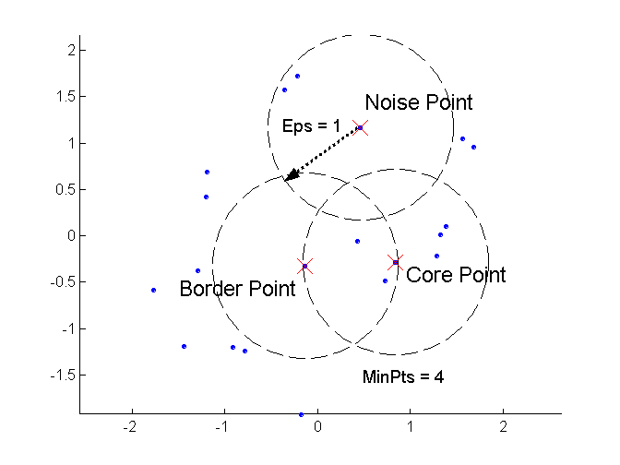
DBSCAN: Core, Border, and Noise Points

Slide 6
Density-Based Method: DBSCAN
Є-neighborhood: Points within Є distance of a point.
N_{Є} (p) :{q belongs to D | dist(p,q) <= Є}
Core point: Є -neighborhood dense enough (MinPts)
Directly density-reachable: A point p is directly density-reachable from a point q if the distance is small (Є ) and q is a core point.
1) p belongs to N_{Є} (q)
2) core point condition:
| N_{Є} (q)| >= MinPts
p
MinPts = 5
Eps = 1 cm
q

Slide 7
Density-Based Method: DBSCAN
Density-reachable: A point p is density-reachable from a point q wrt. Є , MinPts if there is a chain of points p₁, …,p_{n}, p₁ = q, p_{n} = p such that p_{i+1} is directly density-reachable from p_{i}
p
p₁
q
Density Reachability
Density-connected: A point p is density-connected to a point q wrt. Є , MinPts if there is a point o such that both, p and q are density-reachable from o wrt. Є and MinPts.
p
q
o
Density Connectivity

Slide 8
DBSCAN
Relies on a density-based notion of cluster: A cluster is defined as a maximal set of density-connected points w.r.t. density reachability
Every object not contained in any cluster considered as noise
Discovers clusters of arbitrary shape in spatial databases with noise
Outlier
Border
Eps = 1cm
MinPts = 5
Core

Slide 10
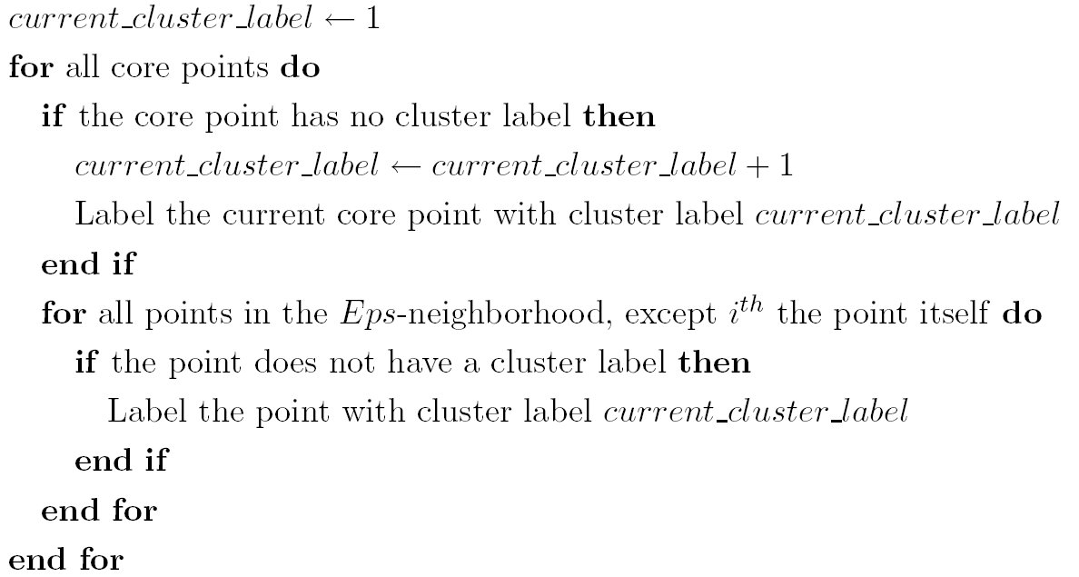
DBSCAN Algorithm
Eliminate noise points
Perform clustering on the remaining points

Slide 11
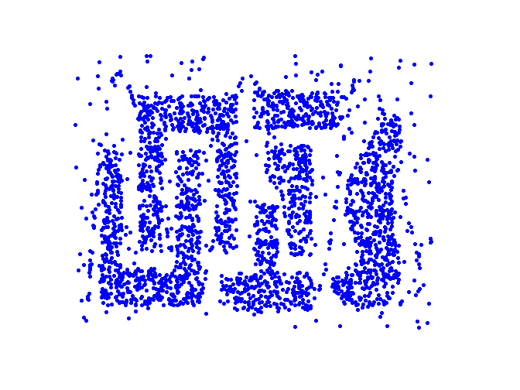
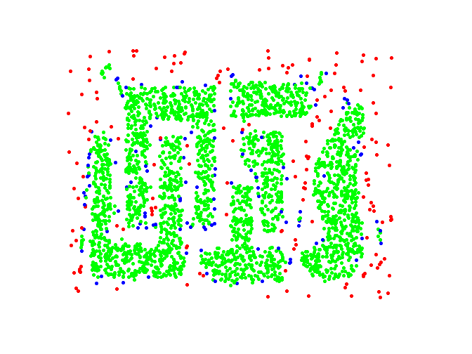
DBSCAN: Core, Border and Noise Points
Original Points
Point types: core, border and noise
Eps = 10, MinPts = 4

Slide 12
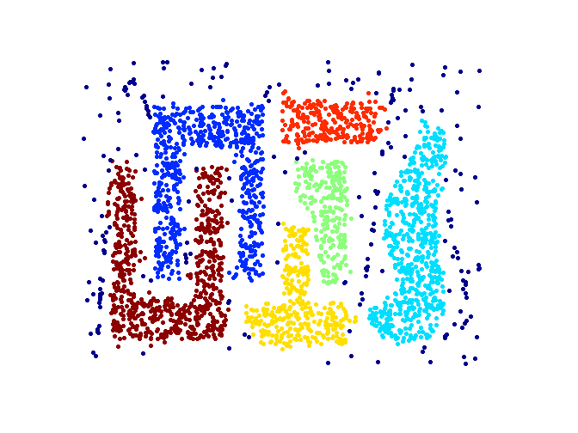
When DBSCAN Works Well
Original Points
Clusters
Resistant to Noise
Can handle clusters of different shapes and sizes

Slide 13
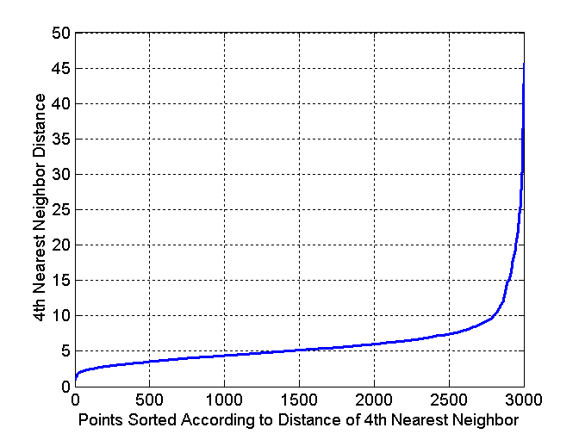
DBSCAN: Determining EPS and MinPts
Idea is that for points in a cluster, their k^{th} nearest neighbors are at roughly the same distance
Noise points have the k^{th} nearest neighbor at farther distance
So, plot sorted distance of every point to its k^{th} nearest neighbor
Original Points

Slide 14
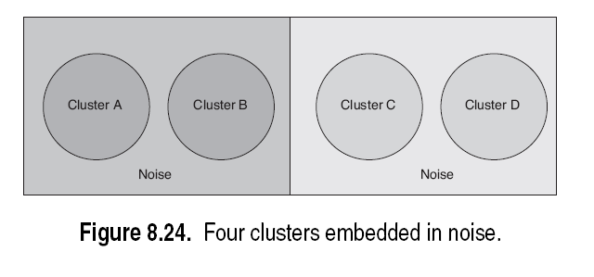
Clusters of Varying Density

Slide 15
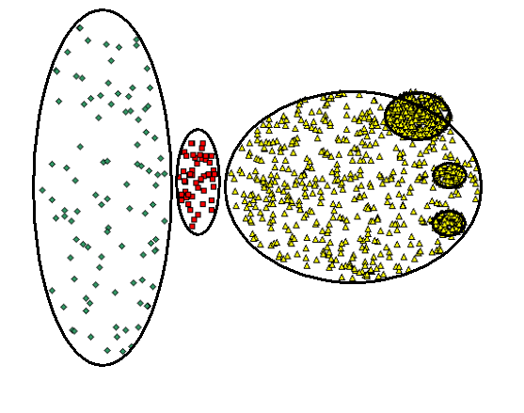
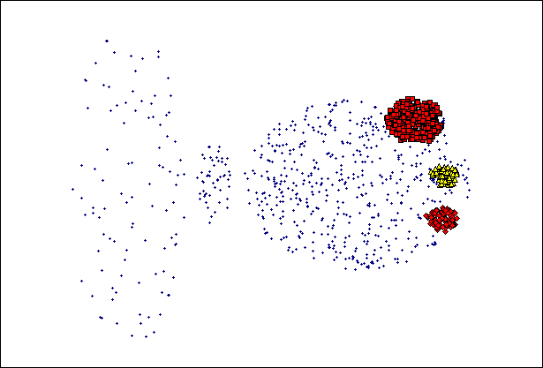
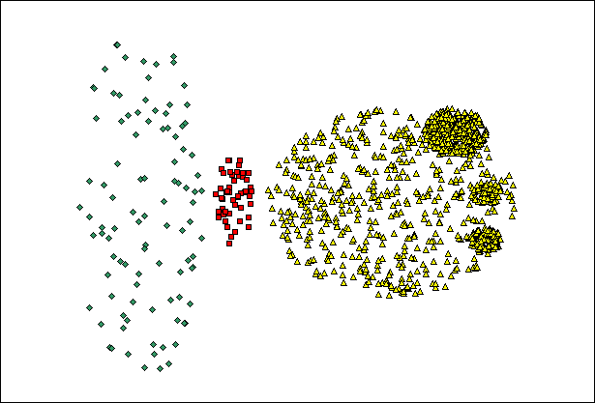
When DBSCAN Does NOT Work Well
(MinPts=4, Eps=9.75).
Original Points
Varying densities
High-dimensional data
(MinPts=4, Eps=9.62)

Slide 16
k-Medoids Clustering Method
k-medoids: Find k representative objects, called medoids
PAM (Partitioning Around Medoids, 1987)
CLARA (Kaufmann & Rousseeuw, 1990)
CLARANS (Ng & Han, 1994): Randomized sampling
10
9
8
7
6
5
4
3
2
1
0
0
1
2
3
4
5
6
7
8
9
10
k-means
k-medoids

Slide 17
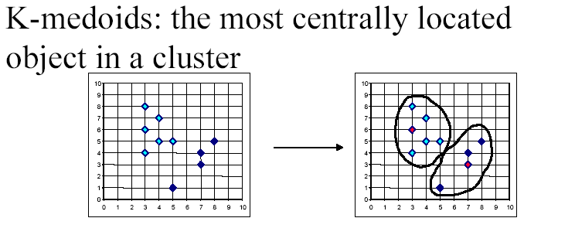
K-medoids

Slide 18
PAM
Partitioning Around Medoids (PAM) (K-Medoids)
Handles outliers well.
Ordering of input does not impact results.
Does not scale well.
Each cluster represented by one item, called the medoid.
Initial set of k medoids randomly chosen

Slide 19
PAM: Basic Strategy
First find a representative object (the medoid) for each cluster
Each remaining object is clustered with the medoid to which it is most “similar”
Iteratively replace one of the medoids by a non-medoid as long as the “quality” of the clustering is improved

Slide 20
Typical k-medoids algorithm (PAM)
10
9
8
Arbitrary choose k object as initial medoids
Assign each remaining object to nearest medoids
7
6
5
4
3
2
1
0
0
1
2
3
4
5
6
7
8
9
10
K=2
Randomly select a nonmedoid object,O_{ramdom}
Do loop
Until no change
10
10
9
Compute total cost of swapping
9
Swapping O and O_{ramdom}
If quality is improved.
8
8
7
7
6
6
5
5
4
4
3
3
2
2
1
1
0
0
1
2
3
4
5
6
7
8
9
10
0
0
1
2
3
4
5
6
7
8
9
10

Slide 21
PAM (Partitioning Around Medoids)
PAM (Kaufman and Rousseeuw, 1987)
Arbitrarily choose k objects as the initial medoids
Until no change, do
(Re)assign each object to the cluster with the nearest medoid
Improve the quality of the k-medoids
(Randomly select a nonmedoid object, O_{random},
compute the total cost of swapping a medoid with
O_{random)}
Work for small data sets (100 objects in 5 clusters)
Not efficient for medium and large data sets

Slide 22
What is the problem with PAM?
Pam is more robust than k-means in the presence of noise and outliers because a medoid is less influenced by outliers or other extreme values than a mean
Pam works efficiently for small data sets but does not scale well for large data sets.
O(k(n-k)² ) for each iteration
where n is # of data,k is # of clusters
Sampling based method,
CLARA(Clustering LARge Applications)

Slide 24
PAM or K-Medoids: Example
Data Objects
9
8
7
6
5
4
A1
2
3
3
4
6
6
7
7
8
7
A2
6
4
8
7
2
4
3
4
5
6
3
4
01
0₂
0₃
0₄
0₅
0₆
0₇
0₈
0₉
⁰10
1
10
9
2
6
8
3
7
5
2
3
4
5
6
7
8
9
Goal: create
two clusters
Choose randmly two medoids
08 = (7,4) and 02 = (3,4)

Slide 25
PAM or K-Medoids: Example
Data Objects
9
8
7
6
5
4
_{cluster1}
3
cluster2
A1
2
3
3
4
6
6
7
7
8
7
A2
6
4
8
7
2
4
3
4
5
6
4
01
0₂
0₃
0₄
0₅
0₆
0₇
0₈
0₉
⁰10
1
10
9
2
6
8
3
7
5
2
3
4
5
6
7
8
9
Assign each
object to the
closest representative object
Using L1 Metric (Manhattan), we form the following clusters
Cluster1 = {0₁, 0₂, 0₃, 0₄}
Cluster2 = {05, 06, 07, 08, 09, 010}

Slide 26

PAM or K-Medoids: Example
Data Objects
9
8
7
6
5
4
_{cluster1}
3
cluster2
A1
2
3
3
4
6
6
7
7
8
7
A2
6
4
8
7
2
4
3
4
5
6
4
01
0₂
0₃
0₄
0₅
0₆
0₇
0₈
0₉
⁰10
1
10
9
2
6
8
3
7
5
2
3
4
5
6
7
8
9
Compute the absolute error criterion [for the set of Medoids (O2,O8)]
$$E=\sum_{i=1}^{k}{\sum_{p∈C_{i}}{\left|p−O_{i}\right|=\left(\left|O_{1}−O_{2}\right|+\left|O_{3}−O_{2}\right|+\left|O_{4}−O_{2}\right|\right)+}}$$
$$\left(\left|O_{5}−O_{8}\right|+\left|O_{6}−O_{8}\right|+\left|O_{7}−O_{8}\right|+\left|O_{9}−O_{8}\right|+\left|O_{10}−O_{8}\right|\right)$$

Slide 27
PAM or K-Medoids: Example
Data Objects
9
8
7
6
5
4
_{cluster1}
3
cluster2
A1
2
3
3
4
6
6
7
7
8
7
A2
6
4
8
7
2
4
3
4
5
6
4
01
0₂
0₃
0₄
0₅
0₆
0₇
0₈
0₉
⁰10
1
10
9
2
6
8
3
7
5
2
3
4
5
6
7
8
9
The absolute error criterion [for the set of Medoids (O₂,O₈)]
E = (3+4+4)+(3+1+1+2+2) = 20

Slide 28
PAM or K-Medoids: Example
Data Objects
9
8
7
6
5
4
_{cluster1}
3
cluster2
A1
2
3
3
4
6
6
7
7
8
7
A2
6
4
8
7
2
4
3
4
5
6
4
01
0₂
0₃
0₄
0₅
0₆
0₇
0₈
0₉
⁰10
1
10
9
2
6
8
3
7
5
2
3
4
5
6
7
8
9
Choose a random object 0₇
Swap 0₈ and 0₇
Compute the absolute error criterion [for the set of Medoids (0₂,0₇)
E = (3+4+4)+(2+2+1+3+3) = 22

Slide 29
PAM or K-Medoids: Example
Data Objects
9
8
7
6
5
4
_{cluster1}
3
cluster2
A1
2
3
3
4
6
6
7
7
8
7
A2
6
4
8
7
2
4
3
4
5
6
4
01
0₂
0₃
0₄
0₅
0₆
0₇
0₈
0₉
⁰10
1
10
9
2
6
8
3
7
5
2
3
4
5
6
7
8
9
Compute the cost function
Absolute error [0₂ ,0₇ ] - Absolute error [for 0₂ ,0₈ ]
S=22-20
S> 0 => It is a bad idea to replace 0₈ by 0₇

Slide 30
PAM or K-Medoids: Example
Data Objects
9
8
7
6
5
4
_{cluster1}
3
cluster2
A1
2
3
3
4
6
6
7
7
8
7
A2
6
4
8
7
2
4
3
4
5
6
4
01
0₂
0₃
0₄
0₅
0₆
0₇
0₈
0₉
⁰10
1
10
9
2
6
8
3
7
5
2
3
4
5
6
7
8
9
C₆₈₇ = d(0₇,0₆) - d(0₈,0₆)=2-1=1
C₅₈₇ = d(0₇,0₅) - d(0₈,0₅)=2-3=-1
C₉₈₇ = d(0₇,0₉) - d(0₈,0₉)=3-2=1
C₁₀₈₇ = d(0₇,0₁₀) - d(0₈,0₁₀)=3-2=1
C₁₈₇=0, C₃₈₇=0, C₄₈₇=0
TC_{ih}=∑_{j}C_{jih}=1-1+1+1=2=S

Slide 31
Pros & Cons of PAM
PAM is more robust than k-means in the presence of noise and outliers
Medoids are less influenced by outliers
PAM is efficiently for small data sets but
does not scale well for large data sets
O(k(n-k)2 ) for each iteration
Sampling based method: CLARA

